Slide 1

Grand Opening
Strategy and Examples

Slide 2

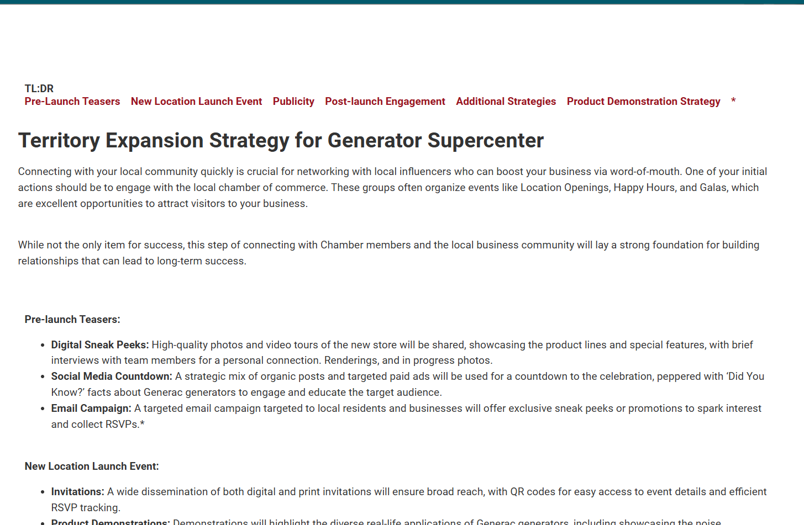
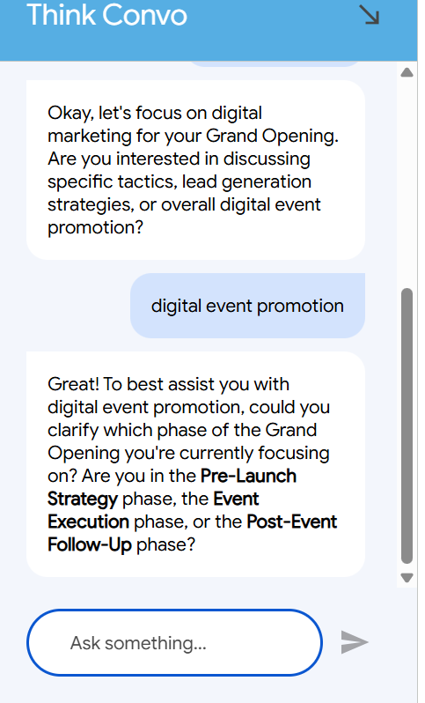
Marketing Strategy Resources
Documents Click to Read More
Territory Expansion Strategy and Chat Bot
PPC Expectations and Strategy
Target Audience Guide
Social Media Strategy
Web Traffic Expectations, Strategy, and Promos

Slide 3
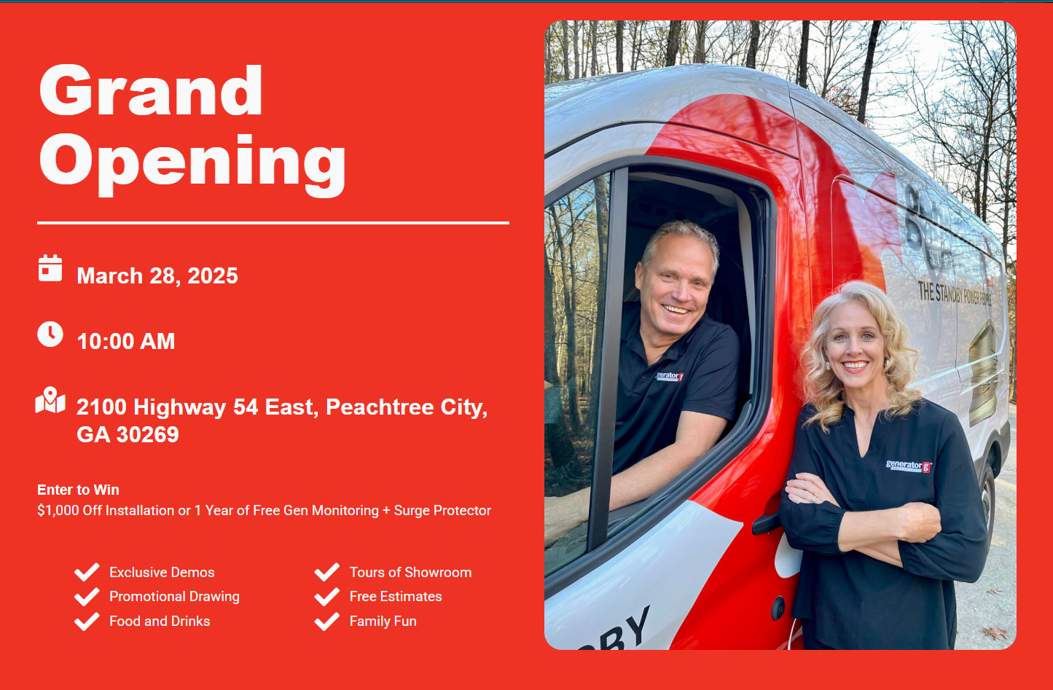
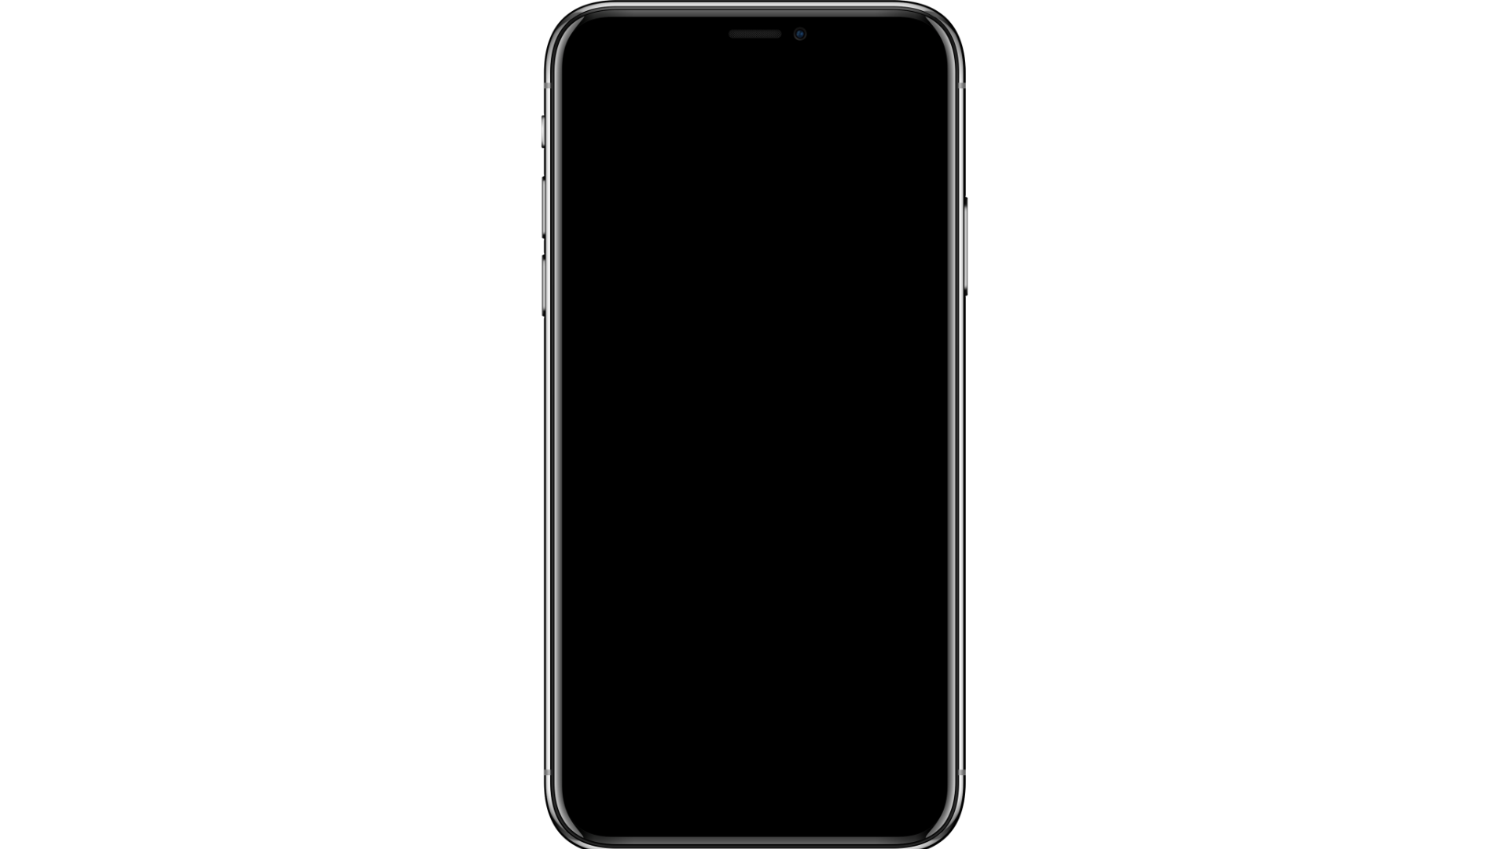
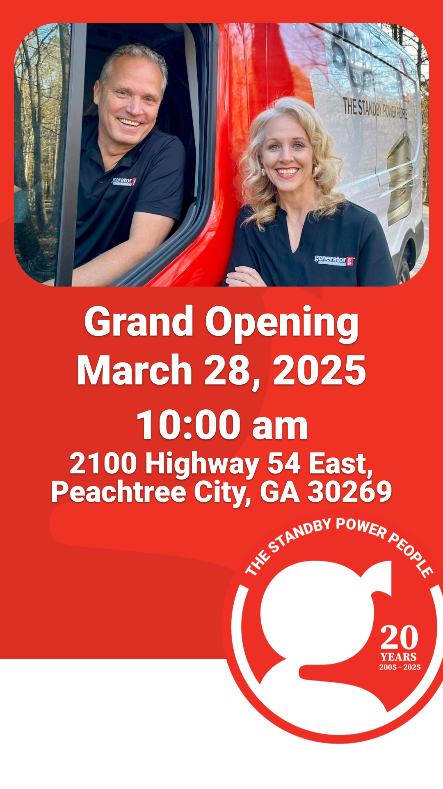

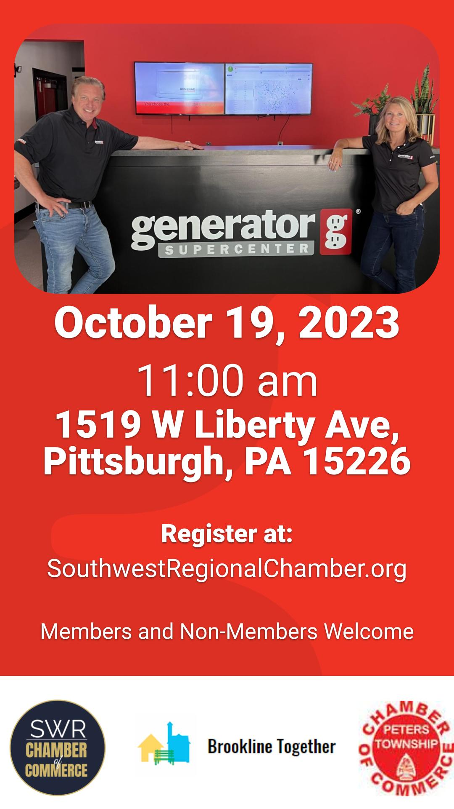

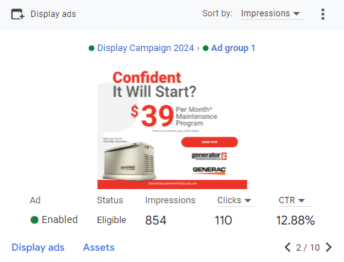

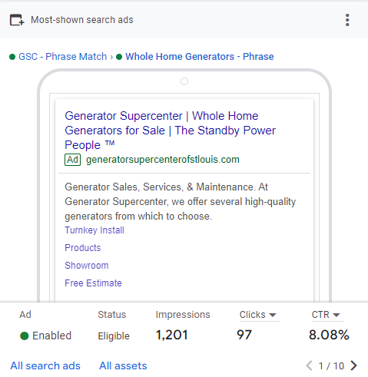
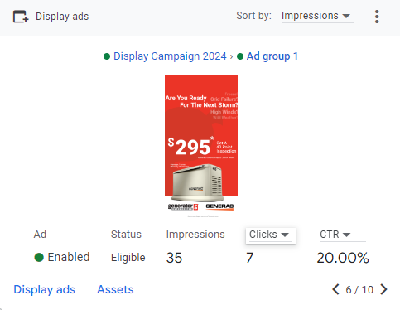
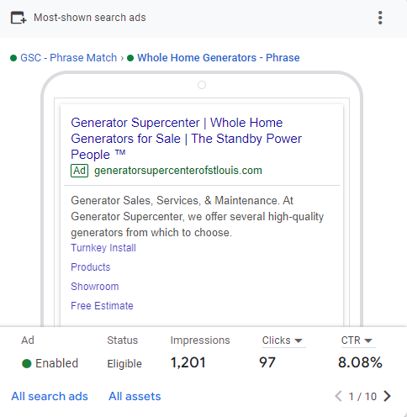

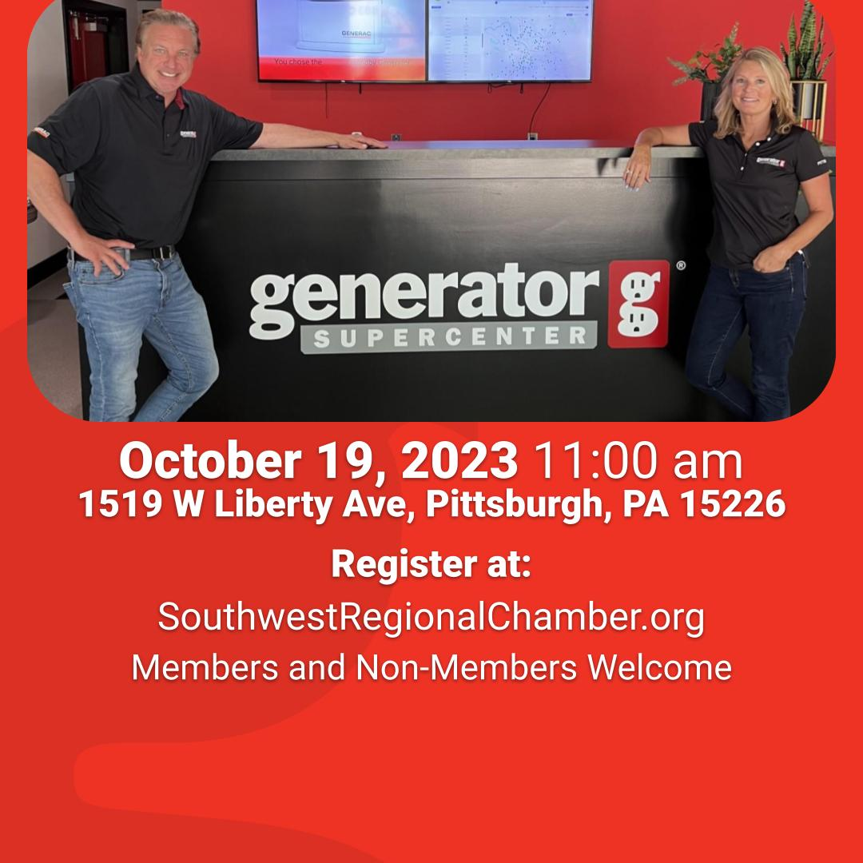

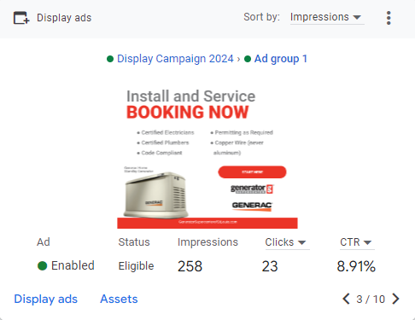

Grand Opening Digital Deliverables
Pre-Event Deliverables ($150)
Facebook Event: Date and time with a link to RSVP
Stories: Rotating creative promoting the Grand Opening Date
Text & Display Ads: Ads for your Grand Opening to showcase services offered.
Landing Page (+$75): generatorsupercenterofsouthatl.com/grand-opening
Pre-event Social Stories
Pre-event Direct Mail
Pre-event Social Posts
Ads

Slide 4
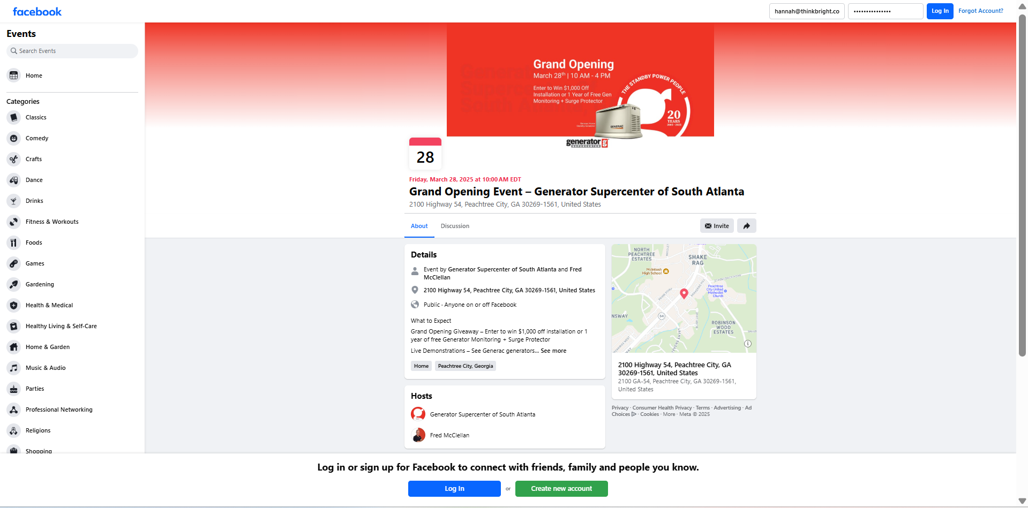

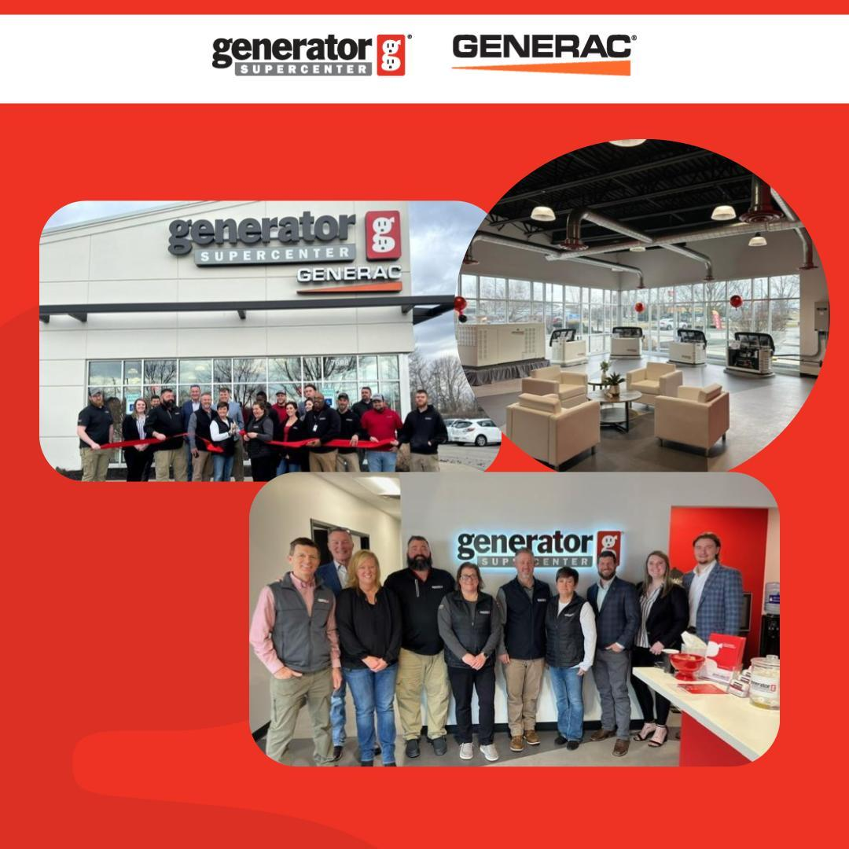
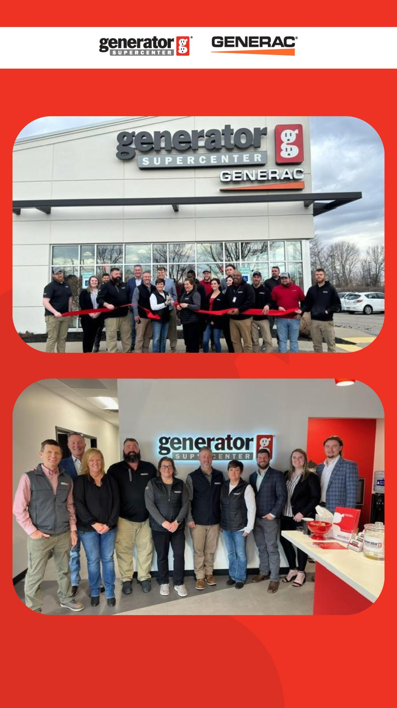
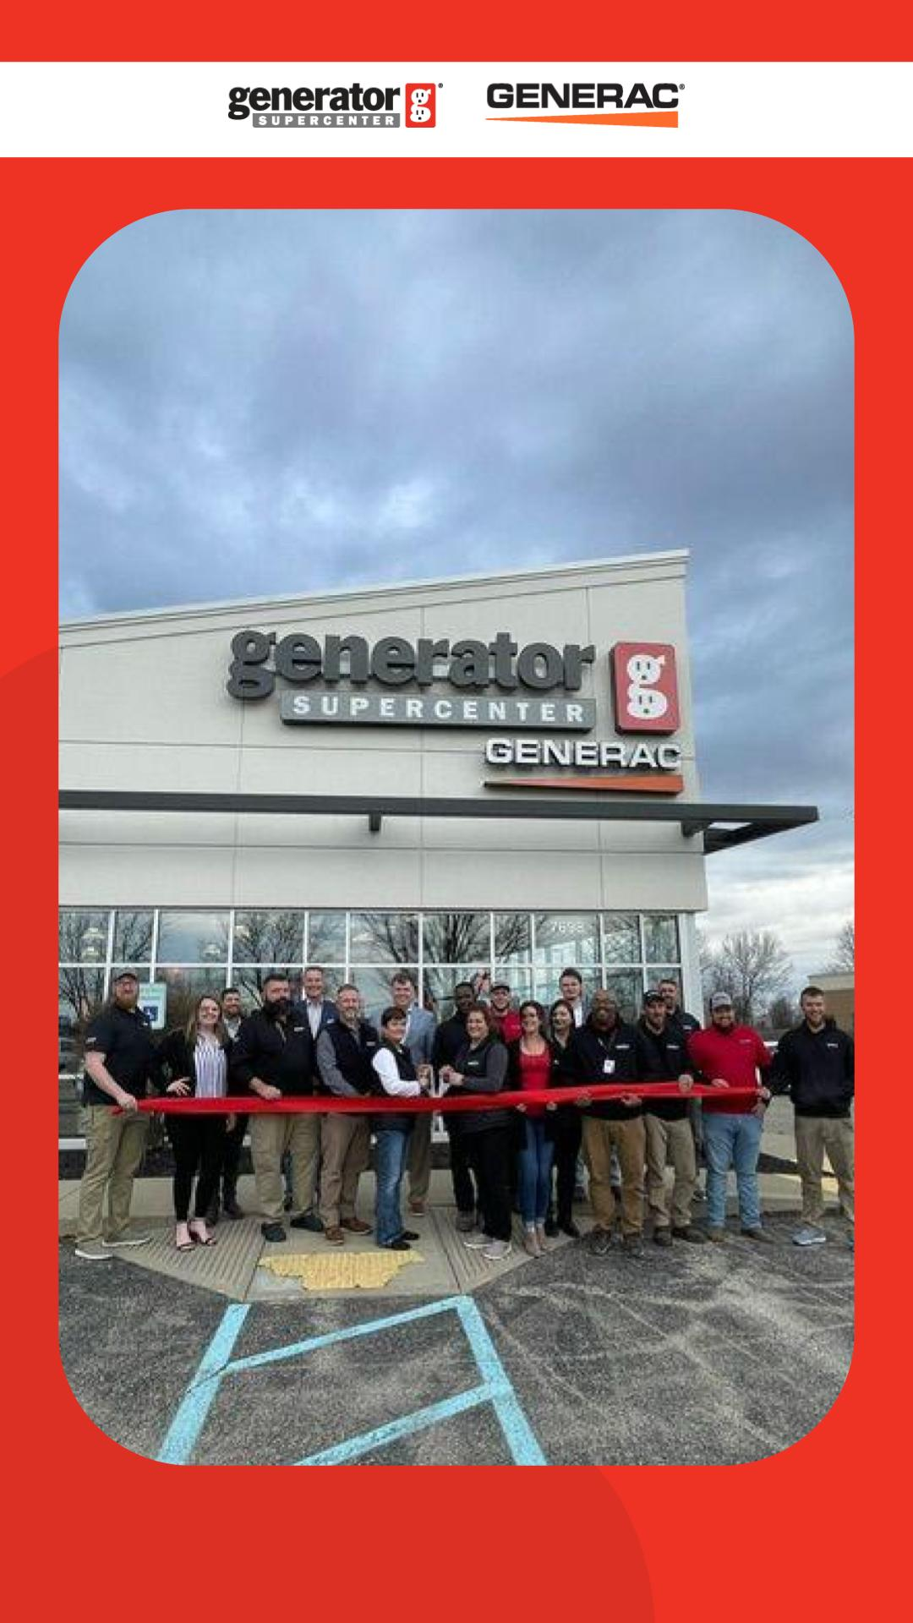
Post-Event Marketing Plans
Recommended Follow-up Posts:
"Thank You for Attending" Social post - Transition messaging from Grand Opening to GenMon or Install Promotions
"Thank You for Attending" Email w/ offer (+$150)
Recommend for 100+ lists.
Post-event social photo carousel
Retargeting Ads to RSVPs & Page Visitors
Post-event Social Feed Post
Post-event Social Stories

Slide 5






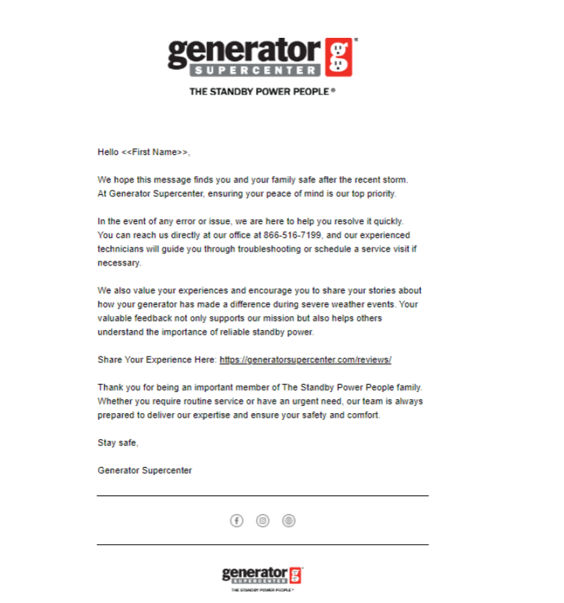

Other Recommended Strategies
Billboards
New Location Opening Set
Recommended:
Showroom Signage - $75
Direct Mail $130
Email - $150 (for non-diamond)
New Showroom Flyer, Banner, Ad Set
Email

Slide 6
Information Needed
Event Details and Photos
Date & Time
Location
What to expect: offers (enter to win/offer to all), demo, ribbon cutting, food/drinks, etc.
Photos of Storefront
Photos of Owner(s)
Budget (for additional ad spend) (if upgrading package for additional services) Recommend - $750 (two week budget, boosted event)

Slide 7
Grand Opening Package Costs
Grand opening package: one-off cost including:
Email for Diamond Partners
Social Graphics
Event Header
5 Stories
Ad Creation
Crossposting on other platforms
Implementation and coordination
Facebook event
Ads management
Reporting
Engaging with users on Facebook
A la carte: one-off cost including:
Billboards & Outdoor Signage
Storefront & Yard Signs
Flyers & Direct Mail
Email Marketing Templates
Chamber of Commerce Flyers & Graphics
Order Your Grand Opening Assets

Slide 8
External Vendors
Catering: light bites & drinks; simple table tent/sign
Chamber of Commerce: schedule ribbon cutting; ask for co-promo
Photographer: 2–3 hrs day-of to capture storefront, ribbon cut, crowd & demos
Radio & TV: Facilitated by Southern Fried Advertising
Notes:
Vendors boost turnout, content, and credibility. The Chamber often adds you to their calendar/newsletter and may share socially. Ask catering to arrive 45–60 min early for setup. For photography, share a quick shot list (storefront, team, ribbon, crowd, demos, partners) and request same-day 5–10 selects with a full gallery within 72 hrs (basic social/web usage is fine). Use Indy and South ATL as quality examples to emulate.

Slide 9
External Vendor Details
Book 2–3 weeks out (Catering, Chamber, Photographer)
Reconfirm 7 days prior; share run-of-show + shot list 48 hrs prior
After event: send promo links, invoices, and photo gallery to our team
Budget tip: add a $750 / 2-week boost (separate from monthly spend)
Notes:
Vendors boost turnout, content, and credibility. The Chamber often adds you to their calendar/newsletter and may share socially. Ask catering to arrive 45–60 min early for setup. For photography, share a quick shot list (storefront, team, ribbon, crowd, demos, partners) and request same-day 5–10 selects with a full gallery within 72 hrs (basic social/web usage is fine). Use Indy and South ATL as quality examples to emulate.

Slide 10

Questions?
If you have any questions or concerns please contact Hannah@ThinkBright.com for additional clarification.
Or ask the chatbot about specific strategies and implementation of the Grand Opening on the HUB: Territory Expansion Strategy and Chat Bot

